Slide 1


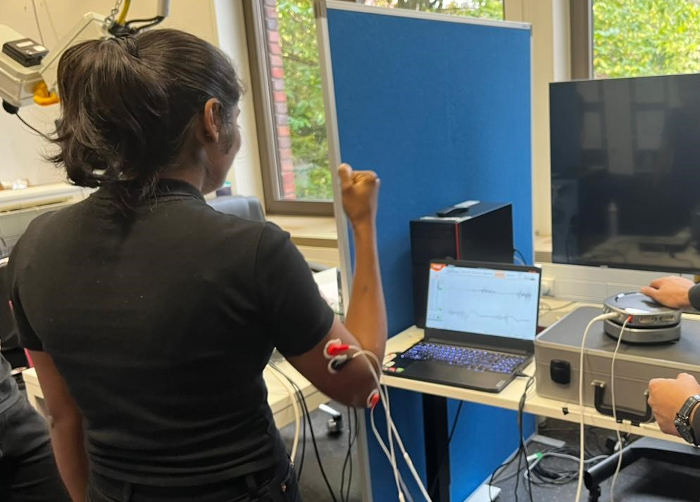
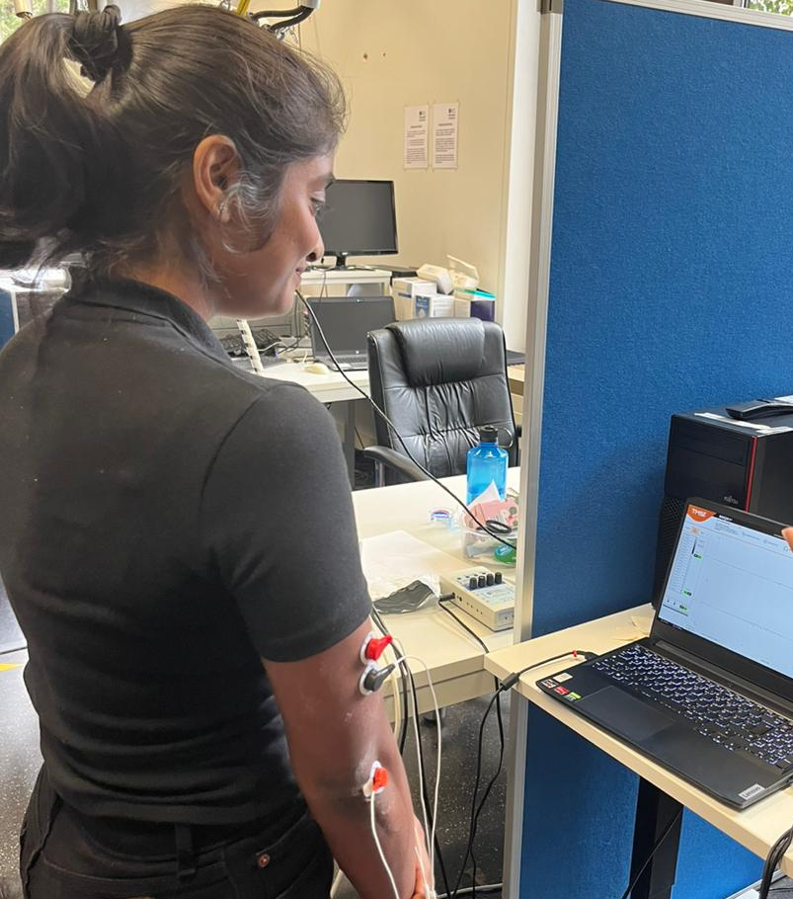
sEMG for Bicep and Tricep
10.11.2023
B.Asha, G.Sabrina, P. Rohan, R.Saad.
1

Slide 2

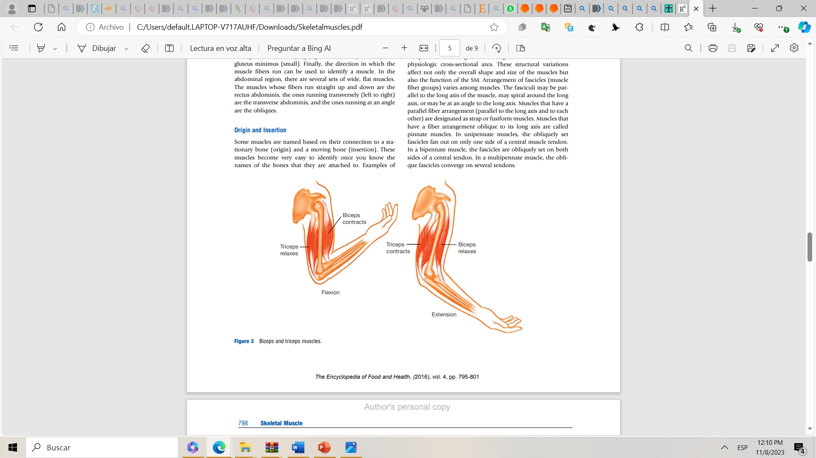
sEMG for Bicep and Tricep
Introduction
• Biopotential basics
What was measured? How is it generated and what can we learn from it?
Introduction
Data acquisition
Signal processing steps
Results
Discussion
Conclusions
References
Key concepts: EMG signals, Muscle contraction, Agonist and antagonist muscles, eccentric and concentric contraction
During this EMG we measured the activity of biceps and triceps in a human subject.
The objective is analyzing how this set of opposite muscles are activated through different set of movements related to the flexion and extension.
[1]
10.11.2023
2

Slide 3
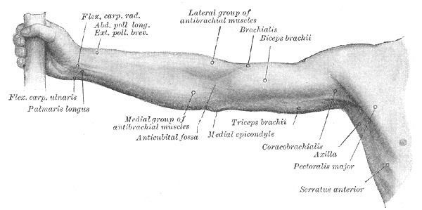
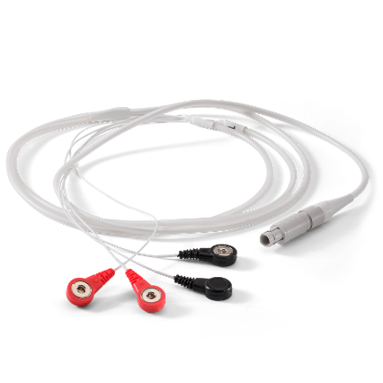
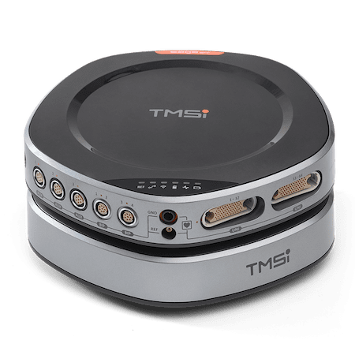
sEMG for Bicep and Tricep
Subject
26 years old, Female
Tasks
MVC of the Bicep
MVC of the Tricep
Bicep curl
Punching
Measurement Set up
Electrodes : Passive electrodes, Bipolar configuration
2 channels: channel 1 tricep, channel 2 bicep, and GND
located on the elbow
Amplifier: TMSI SAGA Data Recorder
Sampling Rate: 2000HZ
Manual Trigger
Introduction
Data acquisition
Signal processing steps
Results
Discussion
Conclusions
References
[2]
[3]
10.11.2023
3

Slide 4
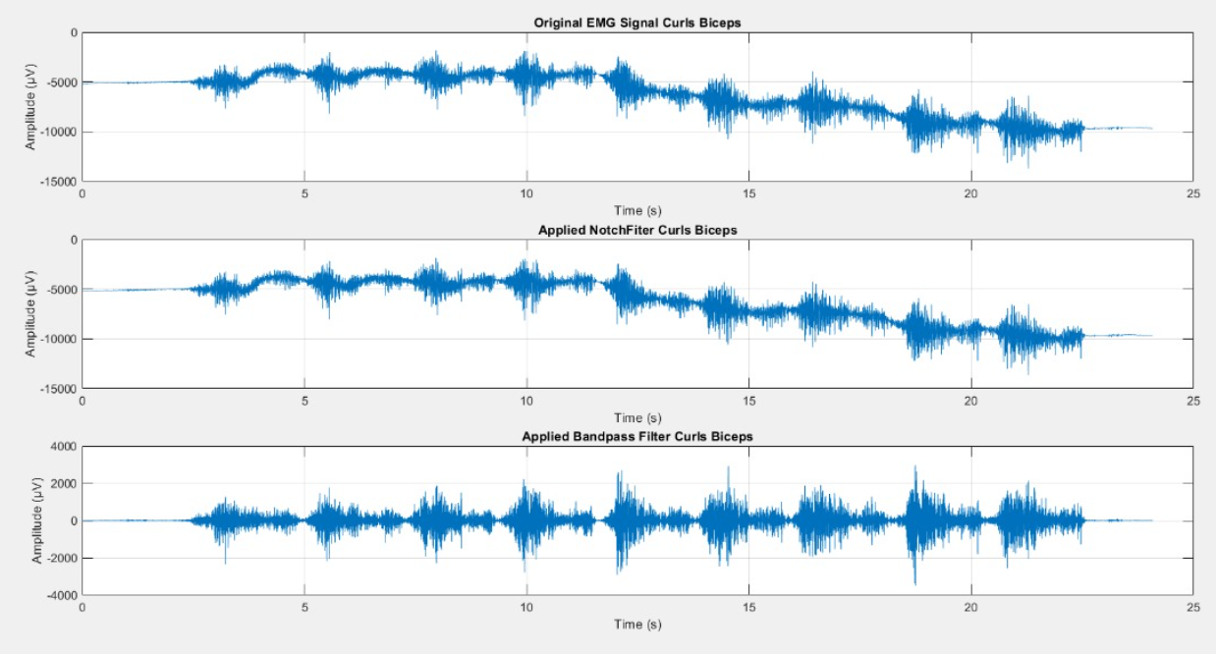
sEMG for Bicep and Tricep
Signal Processing Steps
Filtering: Notch Filter, Band Pass[9]
Cutting the signal.
Introduction
Data acquisition
Signal processing steps
Results
Discussion
Conclusions
References
Task curling
10.11.2023
4

Slide 5
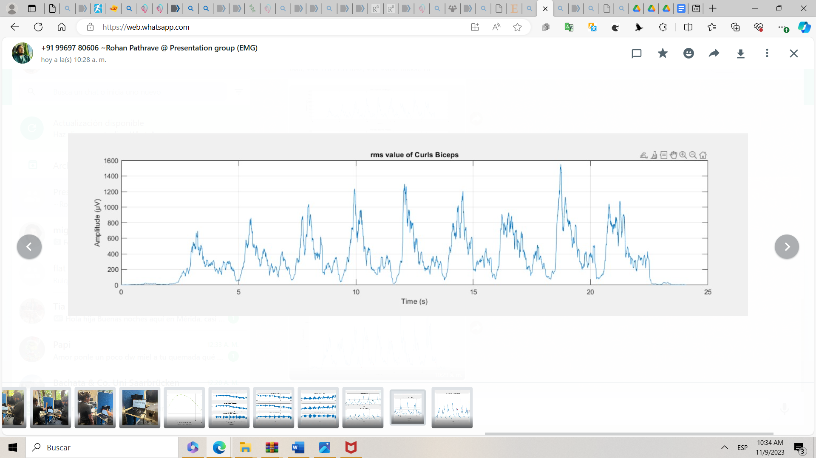
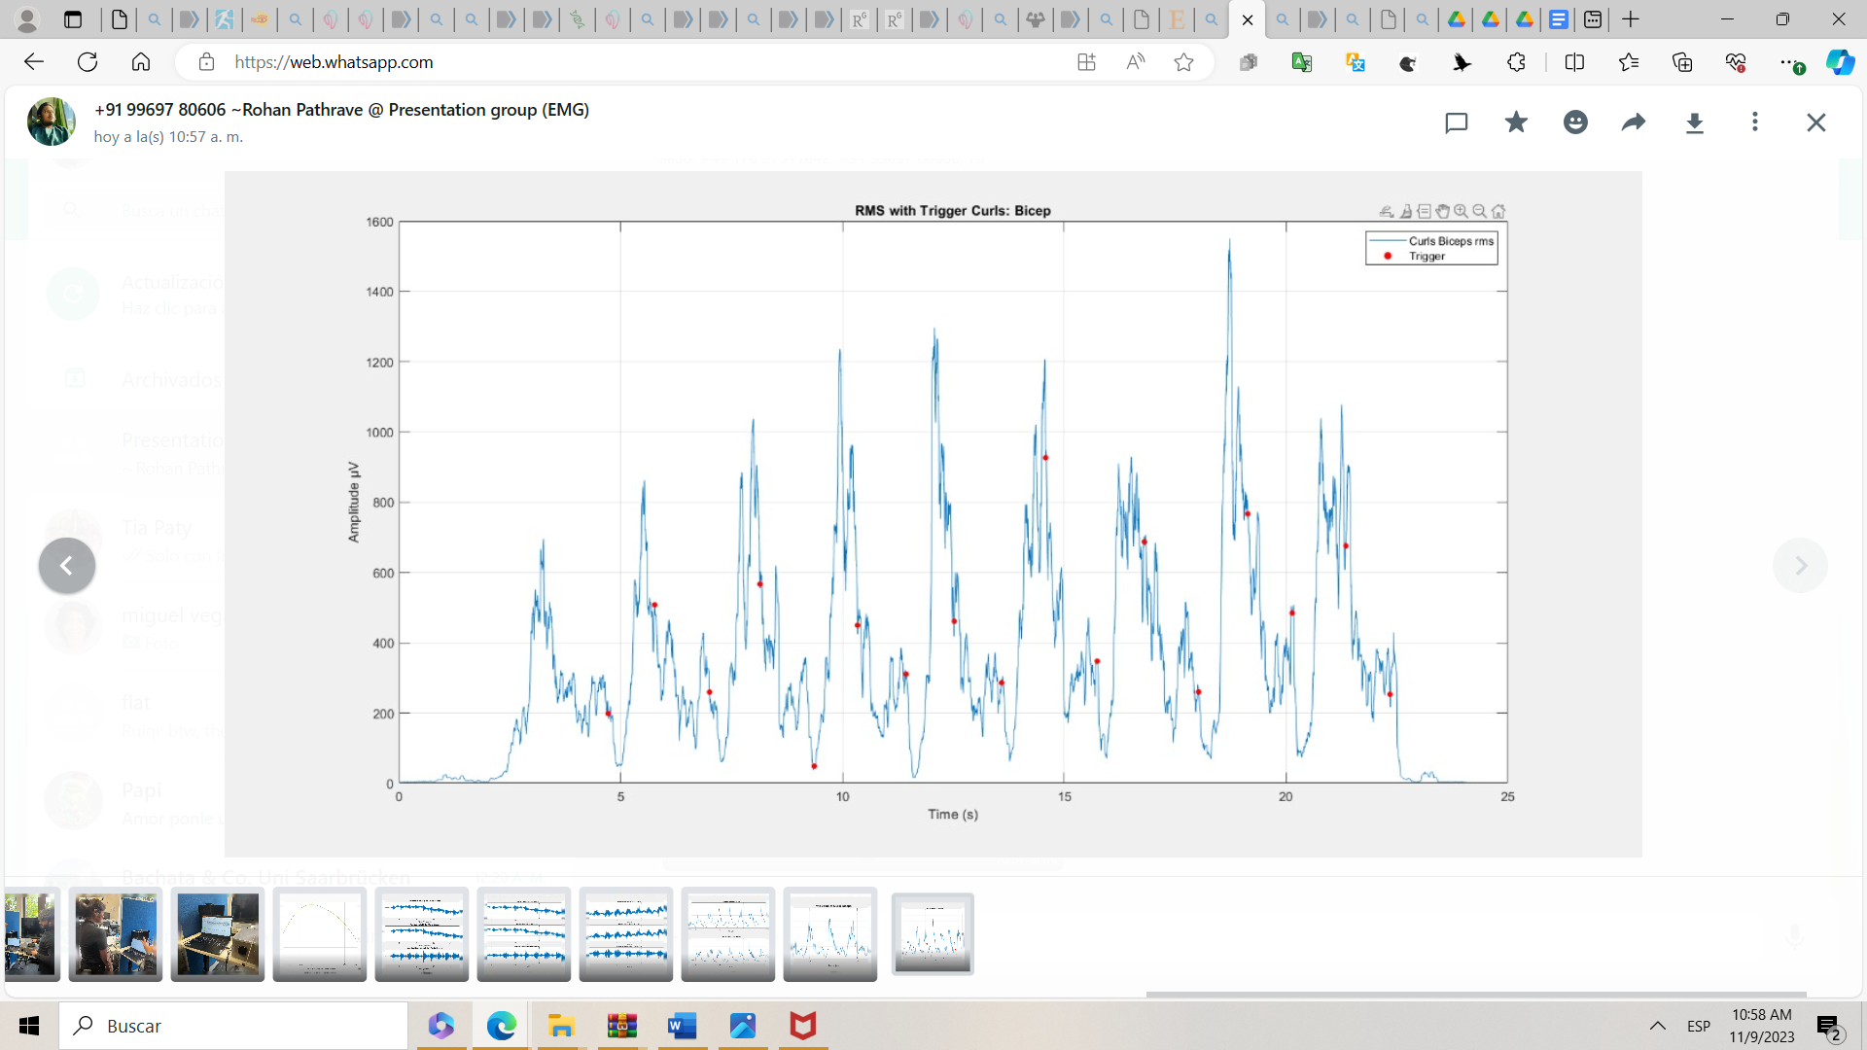
sEMG for Bicep and Tricep
Signal Processing Steps
Enveloping and Indexing.
Introduction
Data acquisition
Signal processing steps
Results
Discussion
Conclusions
References
10.11.2023
5

Slide 6
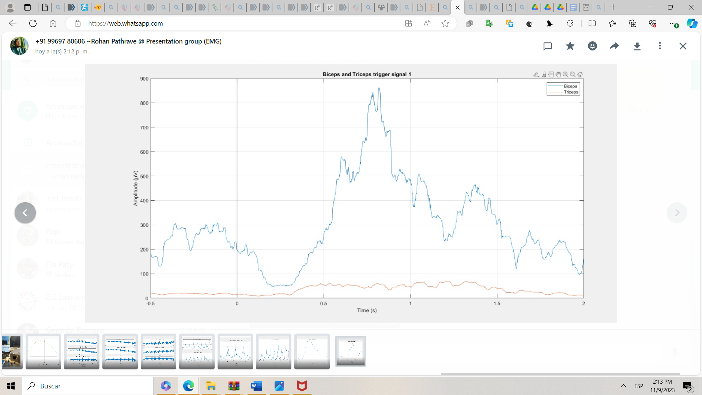
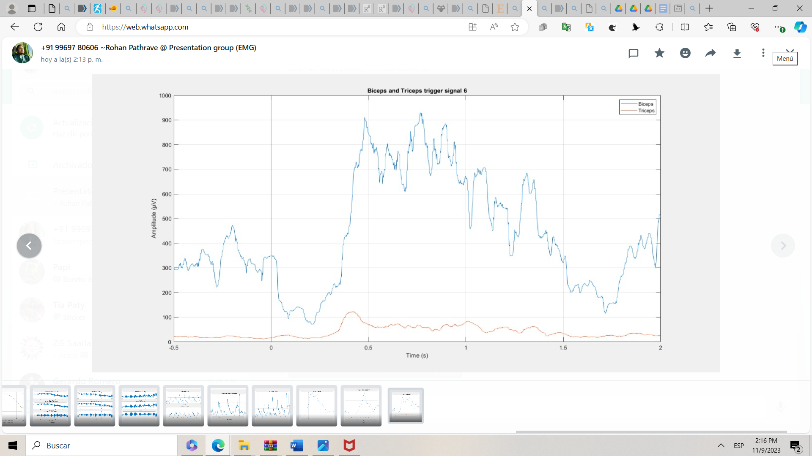
sEMG for Bicep and Tricep
Signal Processing Steps
Introduction
Data acquisition
Signal processing steps
Results
Discussion
Conclusions
References
10.11.2023
6

Slide 7
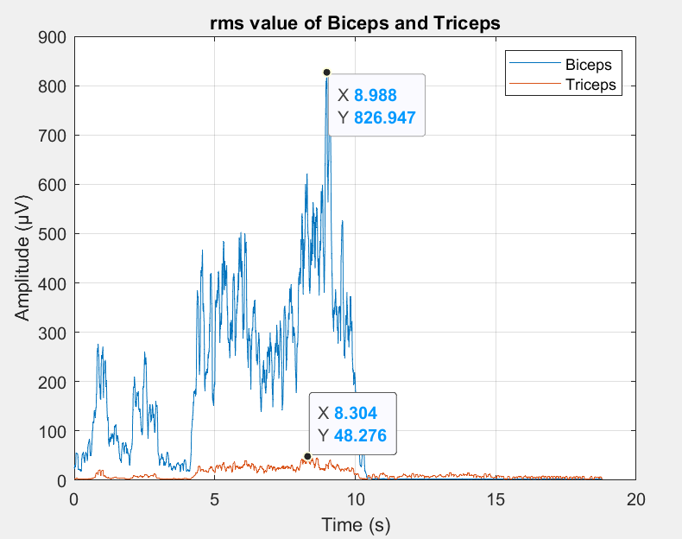
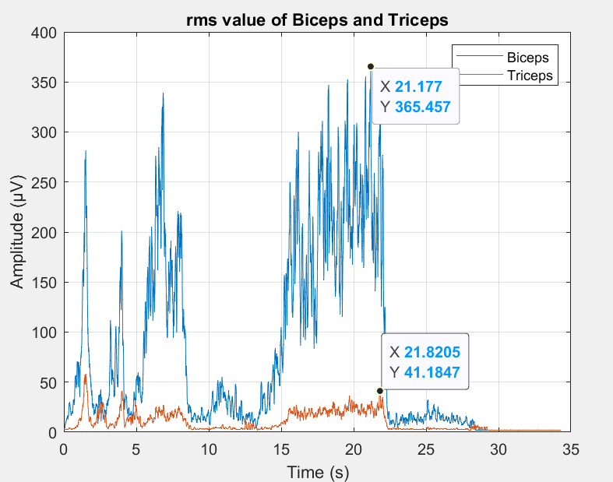
sEMG for Bicep and Tricep
Task 1 & 2 - Comparison of MVC of Biceps Healthy adult and Neuropathic Individual
26 years
Healthy subject
Introduction
Data acquisition
Signal processing steps
Results
Discussion
Conclusions
References
26 years
Neuropathic Subject
10.11.2023
Presenter
7

Slide 8
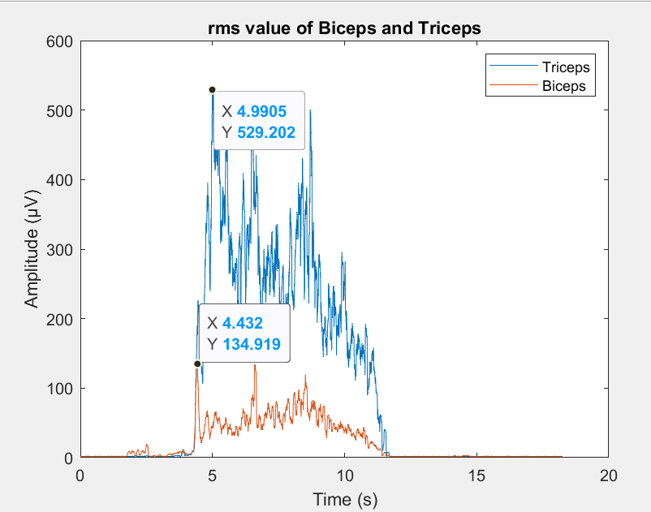
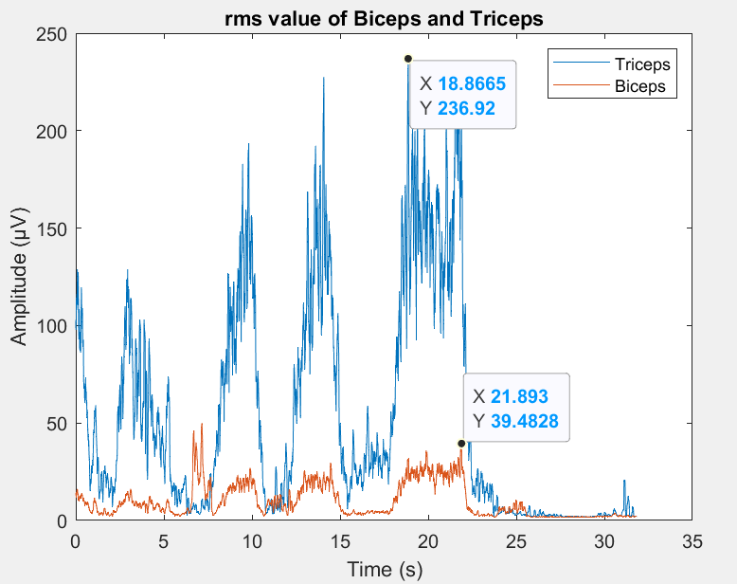
sEMG for Bicep and Tricep
Task 1&2 - Comparison of MVC of Triceps Healthy adult and Neuropathic Individual.
26 years
Healthy subject
Introduction
Data acquisition
Signal processing steps
Results
Discussion
Conclusions
References
26 years
Neuropathic Subject
10.11.2023
8

Slide 9
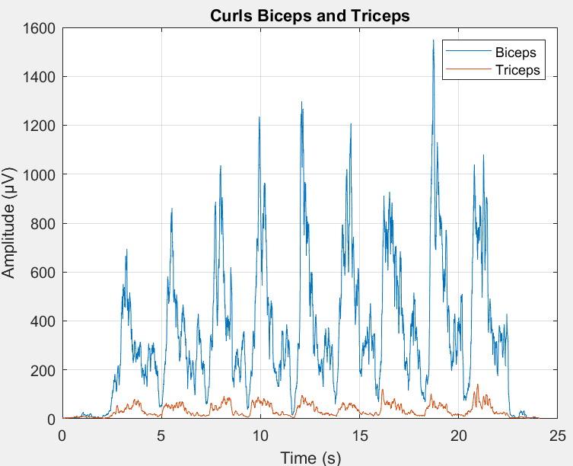
sEMG for Bicep and Tricep
Task 3 - Bicep curl
Introduction
Data acquisition
Signal processing steps
Results
Discussion
Conclusions
References
10.11.2023
9

Slide 10
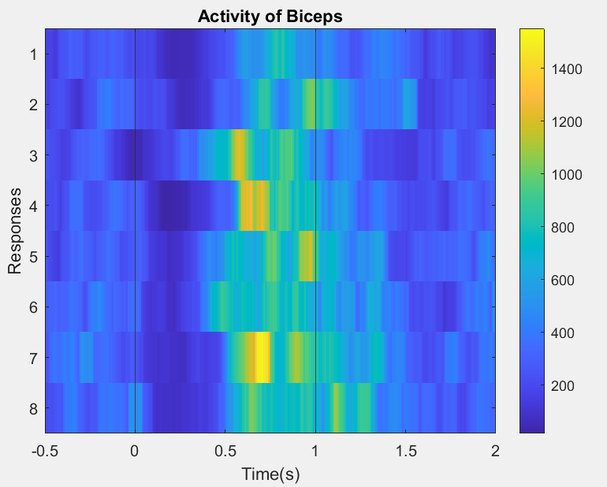
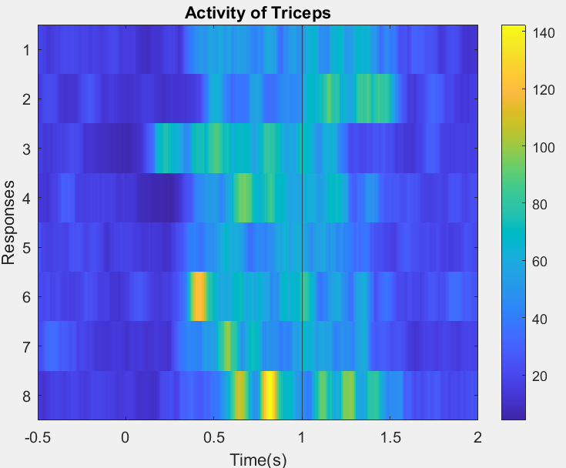
sEMG for Bicep and Tricep
Task 3 - Bicep curl - Colorbar representation
Introduction
Data acquisition
Signal processing steps
Results
Discussion
Conclusions
References
10.11.2023
10

Slide 11
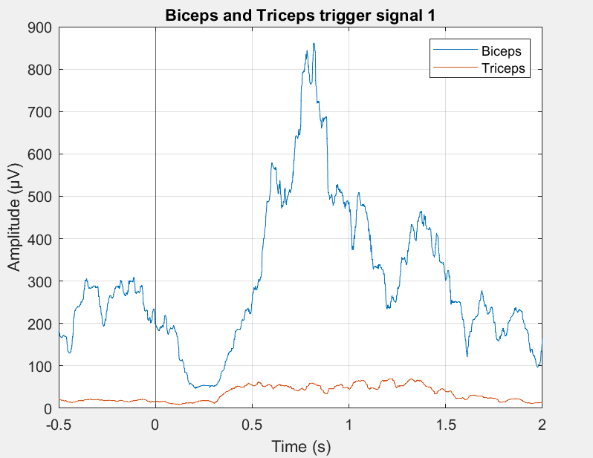
sEMG for Bicep and Tricep
Task 3 - Bicep curl - Trigger wise
Introduction
Data acquisition
Signal processing steps
Results
Discussion
Conclusions
References
10.11.2023
11

Slide 12
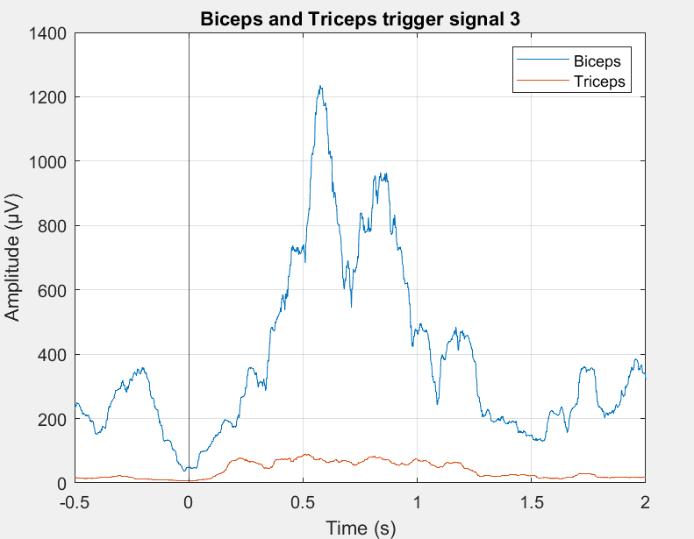
sEMG for Bicep and Tricep
Task 3 - Bicep curl - Trigger wise
Introduction
Data acquisition
Signal processing steps
Results
Discussion
Conclusions
References
10.11.2023
12

Slide 13
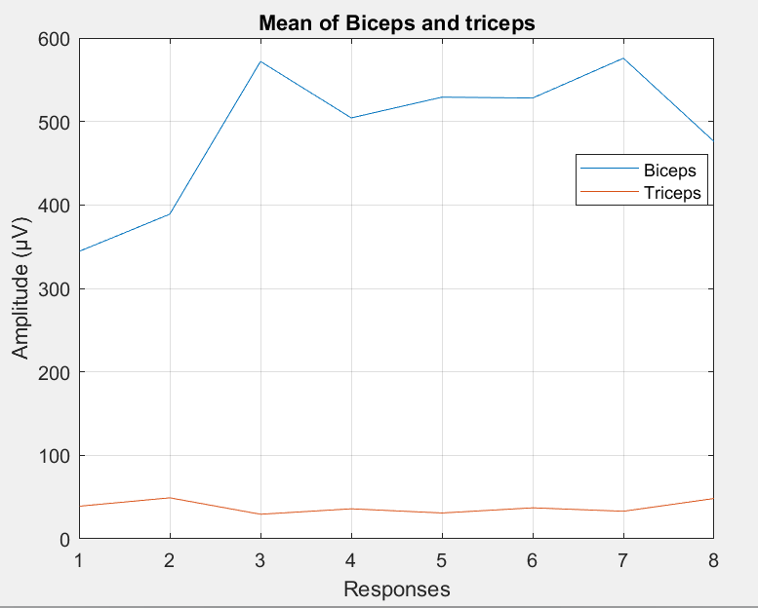
sEMG for Bicep and Tricep
Task 3 - Bicep curl - Fatigue
Introduction
Data acquisition
Signal processing steps
Results
Discussion
Conclusions
References
Muscle fatigue is defined as a decrease in maximal force or power production in response to contractile activity[4]
10.11.2023
13

Slide 14
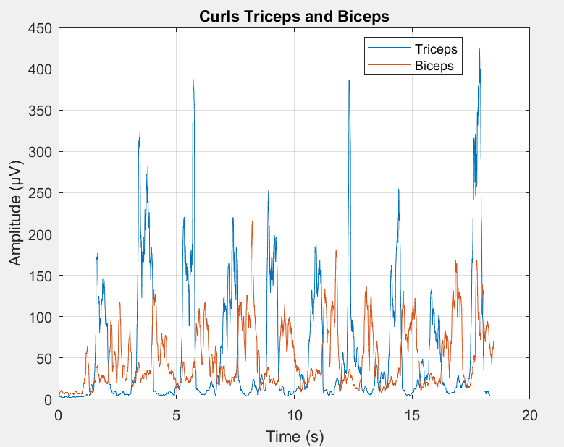
sEMG for Bicep and Tricep
Task 4 - Punching
Introduction
Data acquisition
Signal processing steps
Results
Discussion
Conclusions
References
10.11.2023
14

Slide 15
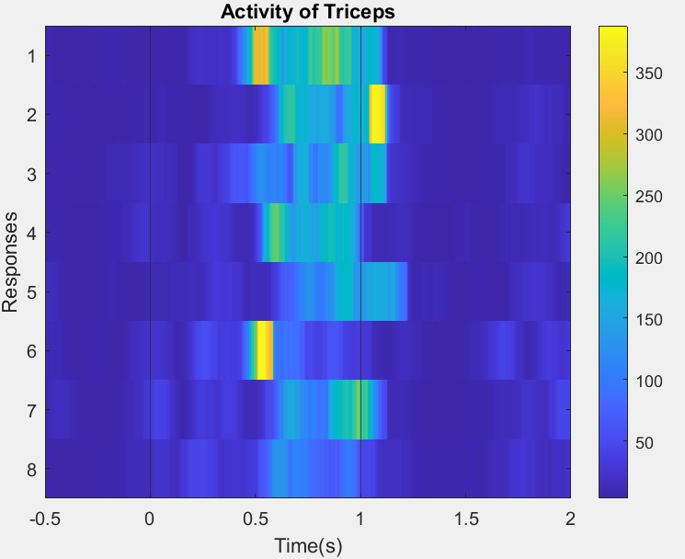
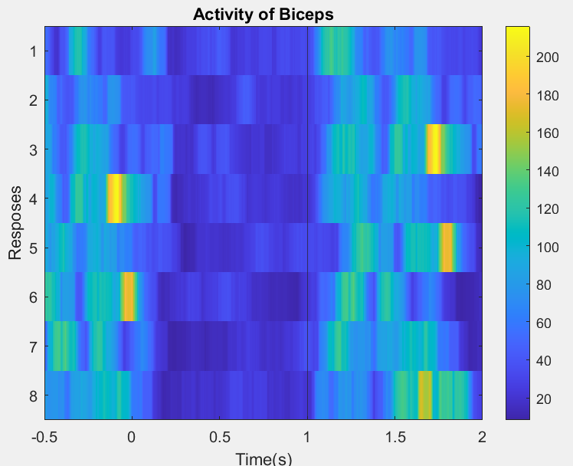
sEMG for Bicep and Tricep
Task 4 - Punching - Colorbar representation
Introduction
Data acquisition
Signal processing steps
Results
Discussion
Conclusions
References
10.11.2023
15

Slide 16
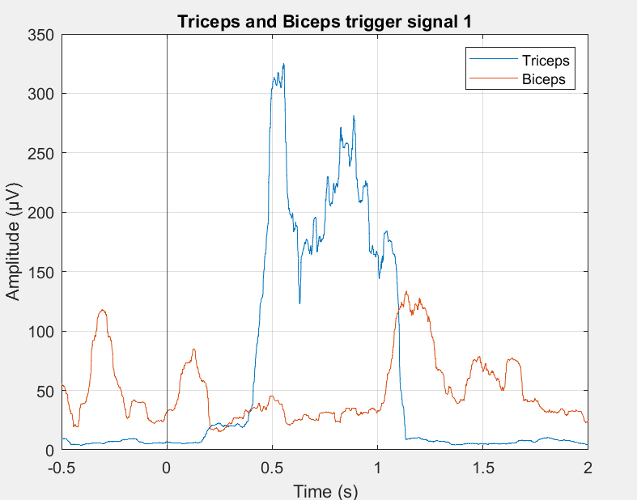
Task 4 - Punching - Trigger wise
Introduction
Data acquisition
Signal processing steps
Results
Discussion
Conclusions
References
10.11.2023
16

Slide 17
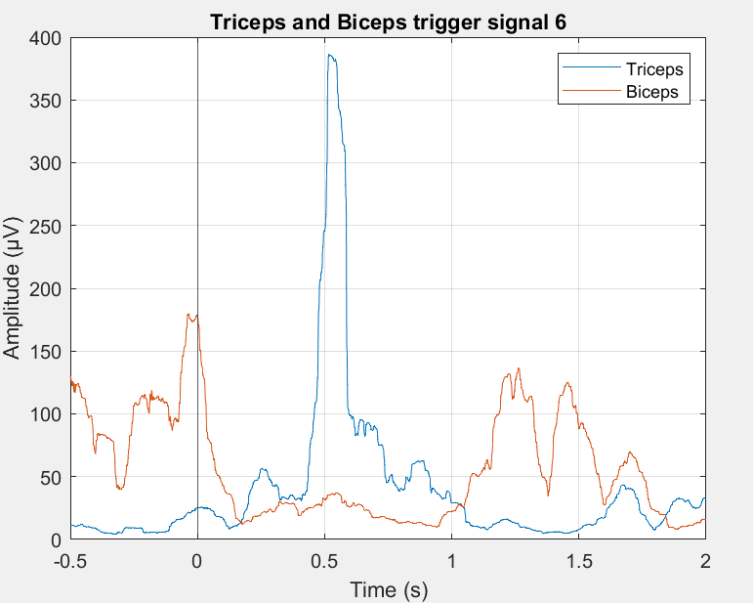
sEMG for Bicep and Tricep
Task 4 - Punching - Trigger wise
Introduction
Data acquisition
Signal processing steps
Results
Discussion
Conclusions
References
10.11.2023
17

Slide 18
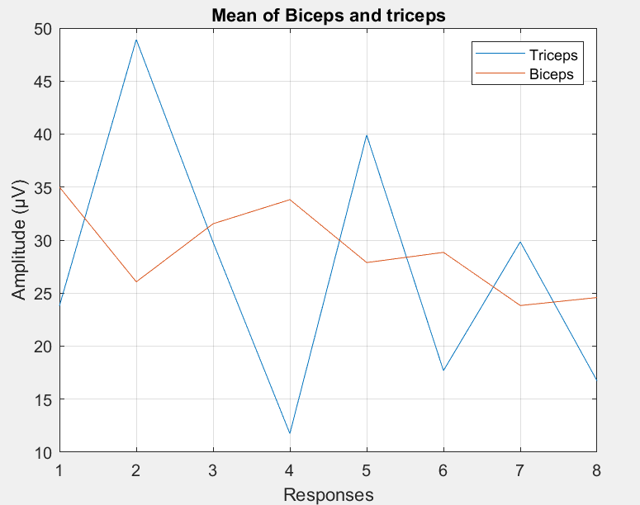
sEMG for Bicep and Tricep
Task 4 - Punching - Fatigue
Introduction
Data acquisition
Signal processing steps
Results
Discussion
Conclusions
References
10.11.2023
18

Slide 19
sEMG for Bicep and Tricep
Discussion
Task 1 and 2 -
Healthy subject has higher values of MVC amplitude in comparison to subjects with neuropathy.
Task 3 and 4 - Analysis of Triphasic pattern and muscle fatigue.
less fatigue in Biceps since the muscle is more used.
Triphasic Pattern in fast movement [Punching] and prominent bicep activity is low flexing of arm[Curls].
Introduction
Data acquisition
Signal processing steps
Results
Discussion
Conclusions
References
10.11.2023
19

Slide 20
sEMG for Bicep and Tricep
Conclusions
To be concluded
→ We did 4 task and observe signals in each task which led us to information that:
→ When we did the exercise there was always a minor activity in the secondary muscle.
→ When you do an exercise repetitively there will be a gradual decrease after certain period of time in motor neuron due to repetitive task which we call fatigue.
→ As we can clearly see the difference between the strength of healthy subjects and neuropathic subjects.
→ This technique can be used to diagnose the neuro-disease like cerebral palsy, strokes.
Introduction
Data acquisition
Signal processing steps
Results
Discussion
Conclusions
References
10.11.2023
20

Slide 21
sEMG for Bicep and Tricep
References
[1] Nayak, Neelam & Khedkar, Chaitali & Khedkar, Chandraprakash & Khedkar, Gulab. (2016). Skeletal muscle.
[2] Tiwana MS, Sinkler MA, Bordoni B. Anatomy, Shoulder and Upper Limb, Triceps Muscle. [Updated 2022 Aug 30]. In: StatPearls [Internet]. Treasure Island (FL): StatPearls Publishing; 2023 Jan-. Available from: https://www.ncbi.nlm.nih.gov/books/NBK536996/
[3] SAGA 32+/64+/128+ - High Density Amplifier - TMSi
[4]Wan JJ, Qin Z, Wang PY, Sun Y, Liu X. Muscle fatigue: general understanding and treatment. Exp Mol Med. 2017 Oct 6;49(10):e384. doi: 10.1038/emm.2017.194. PMID: 28983090; PMCID: PMC5668469. [5] Hallett M. Impact Commentaries. EMG analysis of stereotyped voluntary movements in man. J Neurol Neurosurg Psychiatry. 2012 Feb;83(2):122-3. doi: 10.1136/jnnp-2011-301283. PMID: 22228784.
other information consulted :
Applications, Challenges, and Advancements in Electromyography Signal Processing.
Riley ZA, Maerz AH, Litsey JC, Enoka RM. Motor unit recruitment in human biceps brachii during sustained voluntary contractions. J Physiol. 2008 Apr 15;586(8):2183-93. doi: 10.1113/jphysiol.2008.150698. Epub 2008 Feb 21. PMID: 18292128; PMCID: PMC2465192.
Ashutosh Gupta et al 2017 IOP Conf. Ser.: Mater. Sci. Eng. 225 012128
Daniel J Strauss, Farah I Corona-Strauss, Andreas Schroeer, Philipp Flotho, Ronny, Hannemann, Steven A Hackley (2020) Vestigial auriculomotor activity indicates the direction of auditory attention in humans eLife 9:e54536.
May 2014, DOI: 10.4018/978-1-4666-6090-8, Publisher: IGIGLOBAL ,Editor: Ganesh Naik, ISBN: 9781466660908.
Kirkaya, İzzet & Simsek, Deniz & kaçoğlu, Celil & Soylu, Abdullah. (2021). A 10-Second Measurement of Maximum Voluntary Contractions on Some Muscle Regions: A Cross-Sectional Study. Pakistan Journal of Medical and Health Sciences. 15. 1588-1591.
Introduction
Data acquisition
Signal processing steps
Results
Discussion
Conclusions
References
10.11.2023
21

Slide 22
sEMG for Bicep and Tricep
References
Applications, Challenges, and Advancements in Electromyography Signal Processing.
[6 ] Riley ZA, Maerz AH, Litsey JC, Enoka RM. Motor unit recruitment in human biceps brachii during sustained voluntary contractions. J Physiol. 2008 Apr 15;586(8):2183-93. doi: 10.1113/jphysiol.2008.150698. Epub 2008 Feb 21. PMID: 18292128; PMCID: PMC2465192.
[7] Wan JJ, Qin Z, Wang PY, Sun Y, Liu X. Muscle fatigue: general understanding and treatment. Exp Mol Med. 2017 Oct 6;49(10):e384. doi: 10.1038/emm.2017.194. PMID: 28983090; PMCID: PMC5668469.
[8] Ashutosh Gupta et al 2017 IOP Conf. Ser.: Mater. Sci. Eng. 225 012128
[9] Daniel J Strauss, Farah I Corona-Strauss, Andreas Schroeer, Philipp Flotho, Ronny, Hannemann, Steven A Hackley (2020) Vestigial auriculomotor activity indicates the direction of auditory attention in humans eLife 9:e54536.
Introduction
Data acquisition
Signal processing steps
Results
Discussion
Conclusions
References
10.11.2023
22

Slide 23
Thank you very much for your attention !
10.11.2023
23

